Slide 1
Smart Attendance System based on Face Recognition
Project Developers:
1. Aniket Khetle (Roll no.53)
2. Nitesh Manjarekar (Roll no.21)
3. Nishant Pathare (Roll no.59)
Class : BE
Department : Computer Engineering
Project Guide : Prof. Madhuri Dalal

Slide 2
Introduction
Conventionally attendance in schools, institutes and universities are taken by professors and records are stored in registers.
The objective of this system is to instigate a new approach for taking attendance automatically Face Recognition.
The system will automatically detect the faces of students in classroom and will mark their attendance .

Slide 3
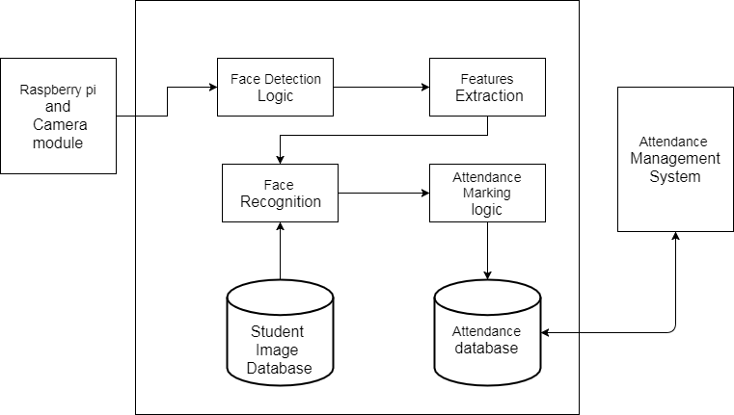
Proposed System
Fig. Architecture diagram

Slide 4
The system is divided into three modules :
Raspberry pi & camera module :
Camera module connected with raspberry pi is placed at such position in classroom from where all students are clearly visible. Camera will record short temporary video, which will be processed by raspberry pi.
Face detection and attendance marking module :
In this section, faces of students are detected and features are extracted from these faces. These features are compared with already existing features in database. According to the result of comparison attendance is marked.
Attendance management module:
This module consists of user interface; through which user can actually see the records of student’s attendance and can generate reports accordingly.

Slide 5
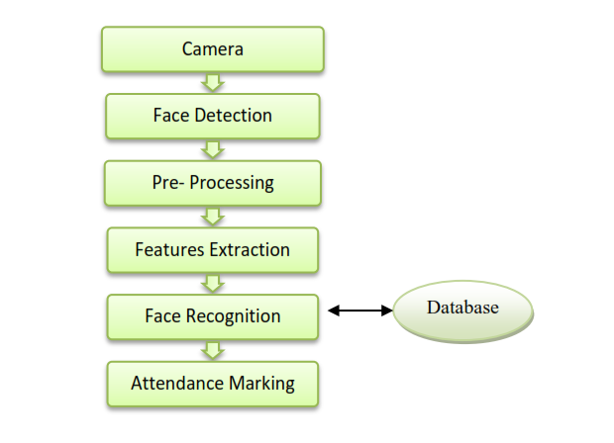
Flowchart

Slide 6
Working Of System
The student database is collected.
The database includes roll numbers of the students & their images.
Camera module connected with raspberry pi is placed at such position in classroom from where all students are clearly visible.
Camera will record short temporary video, which will be processed by raspberry pi.

Slide 7
Camera module will detect the faces of students using Haar Cascade algorithm.
Features will be extracted from detected faces using OpenCV.
These features are compared with already existing features in database
According to the result of comparison attendance is marked.

Slide 8
Hardware requirements
RAM : 512 MB RAM
Hard Drive : 40 GB Hard Drive
Processor : Intel Core 2 Processor
Raspberry pi 3 model
Raspberry pi camera module

Slide 9
Software Requirements
Python 2.7.9 –Python is an interpreted high-level programming language for general-purpose programming. It provides highly efficient features of computer vision.
OpenCV 3.0.0 - (Open Source Computer Vision) is a library of programming functions mainly aimed at real-time computer vision. Features will be extracted from detected faces using OpenCV.
PyQt4 - PyQt is one of the two most popular Python bindings for the Qt cross-platform GUI/XML/SQL C++ framework .
Pyinstaller - PyInstaller is a program that freezes (packages) Python programs into stand-alone executables, under Windows, Linux, Mac OS X, FreeBSD, Solaris and AIX.

Slide 10
Software Requirement for web UI
HTML
Bootstrap
Php
Database :
MySql
Xampp

Slide 11
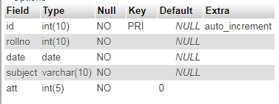

Implementation
1. Database for Website :
Table 1(attendance )
Table 2 (attendance_data)

Slide 12
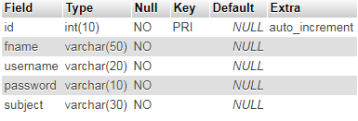
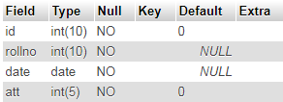
Table 3(checklogin)
Example View (HMI)

Slide 13
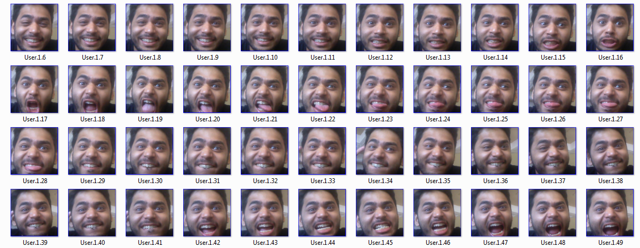
2.Face Features Dataset:

Slide 14
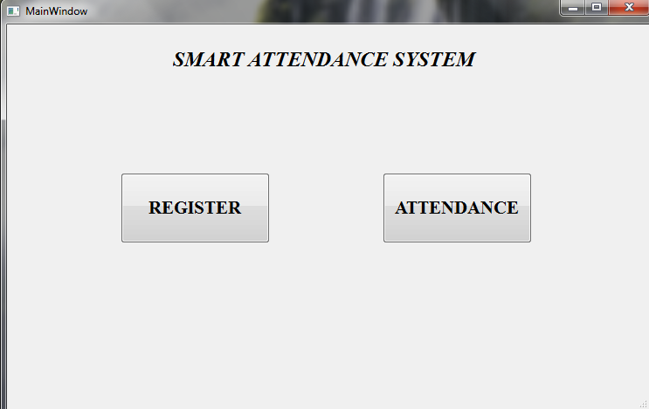
3.Working :
i. Home

Slide 15
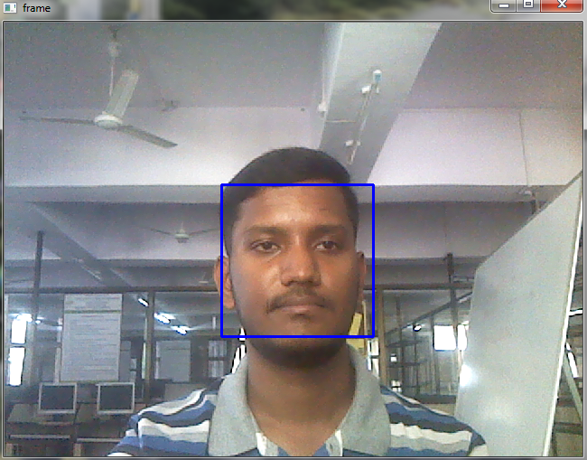
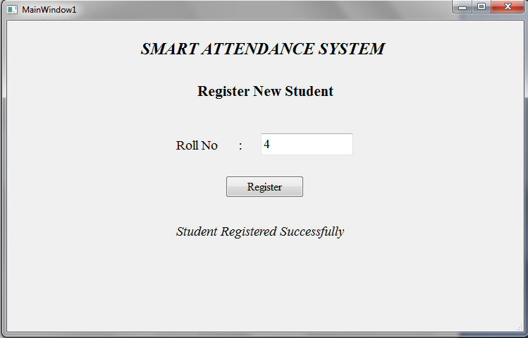
ii. Register

Slide 16
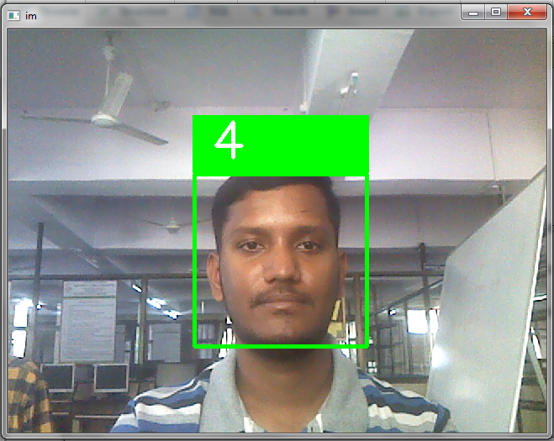
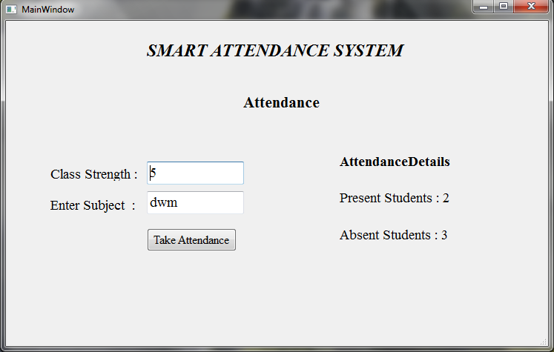
iii. Take attendance :

Slide 17
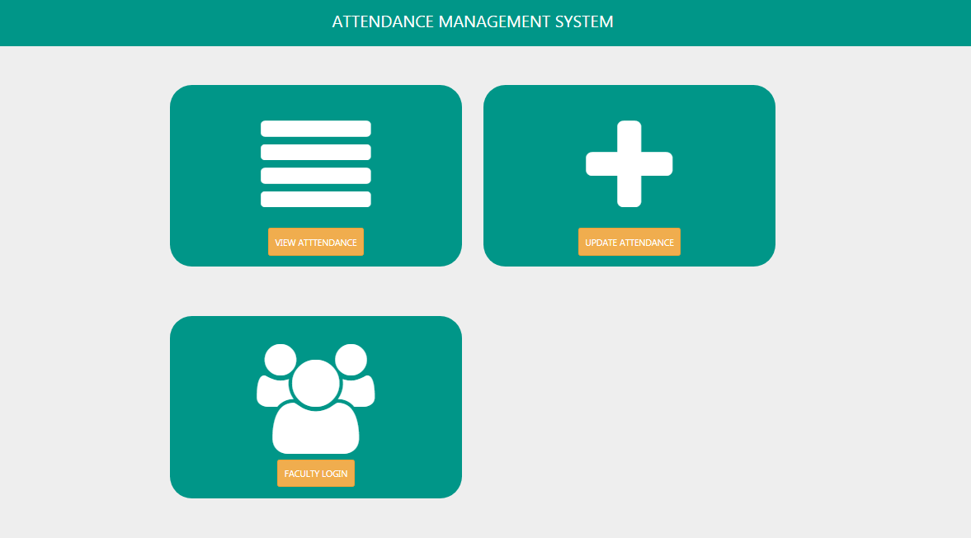
3.Web UI:
i. Home

Slide 18
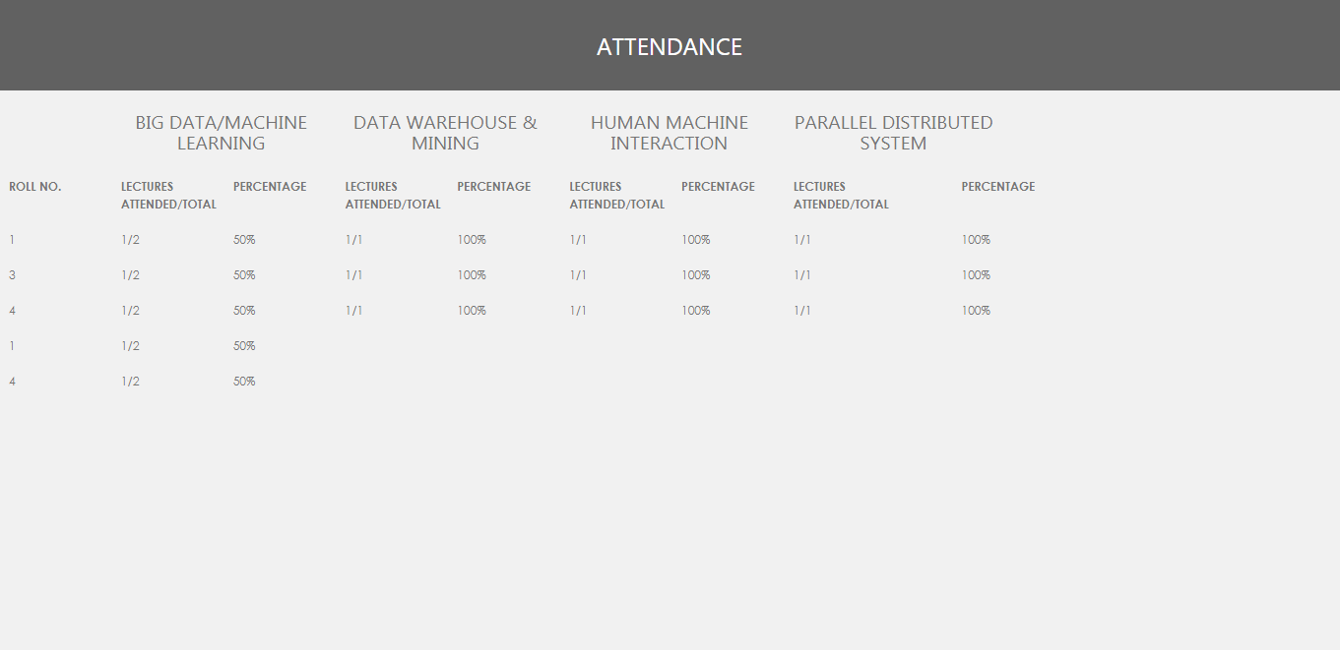
ii. View Attendance Details :

Slide 19
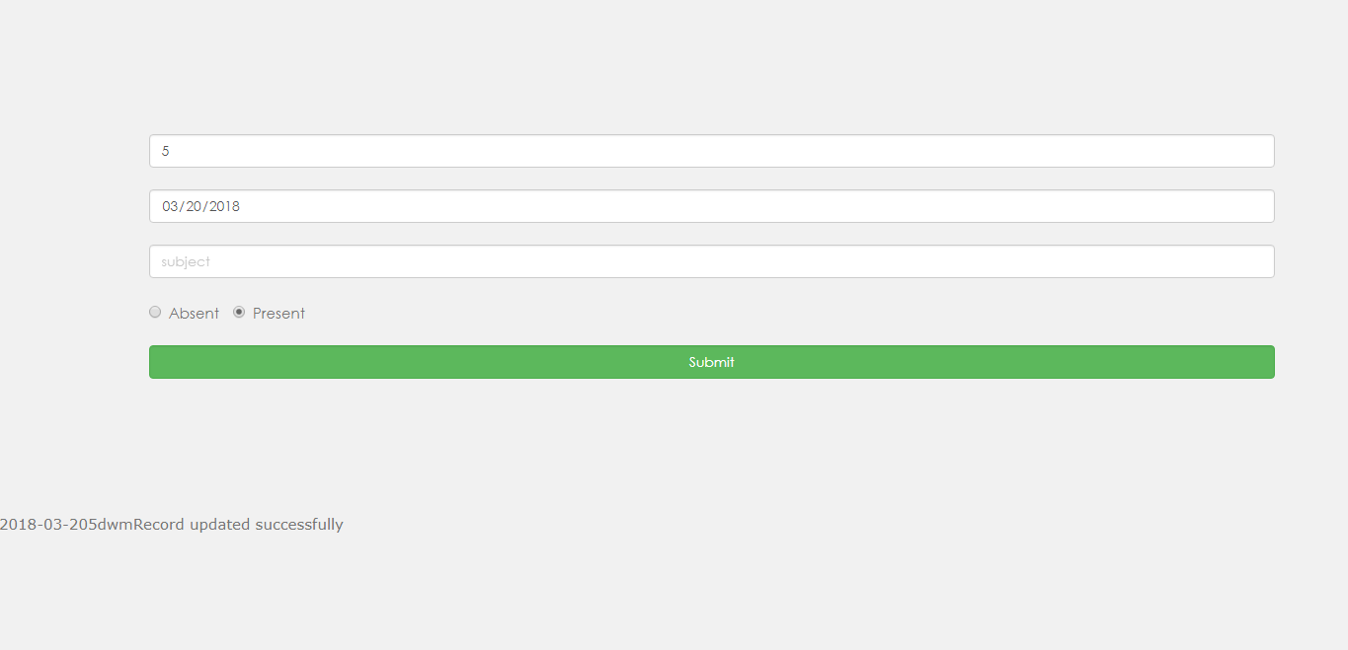
iii. Update attemdance

Slide 20
Future Scope
An android application can be developed so that the availability of the software could be increased.
Instead of using the raspberry pi camera , the photo containing the student’s group photo could be uploaded to the google drive via the android application and can be accessed globally.
We can use the same system with some minor changes in the security sector to detect and recognize unauthorized entities.
The system could be used in corporate sector so as to automatically mark the attendance of the employees and generate a payroll.

Slide 21
Conclusions
Our automated attendance management system is user friendly, easy to use and provides a better security and privacy than manual attendance system.
This system saves time by eliminating the manual tedious work and provide attendance analysis easily through website.

Slide 22
Thank you.

